Slide 1
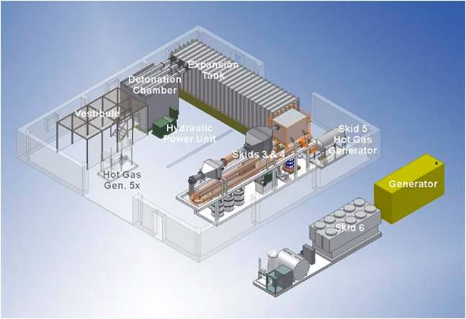
Demilitarization Controlled Detonation Chamber (CDC)
Donovan Technology, Inc.
August 1, 2018

Slide 2
Technology and Compliance
Drawing on decades of knowledge, experience, testing and on-site applications, Donovan Controlled Detonation Chamber (CDC) has become an industrial leader in destruction of munitions and suspected explosives of concern. It was the only one approved by the U.S. Department of Defense Explosive Safety Board for the destruction of conventional munitions and chemical warfare material (CWM). It meets all environmental and safety standards, and is considered the most cost-effective available method for unexploded ordnance (UXO) and CWM destruction.
Donovan Controlled Detonation Chamber meets the DOD TM5-1300 standard, the ASTM Impulse loaded code case, and standards set by American Welding Society and American Institute of Steel Construction;
Demonstration/Validation testing was concluded successful at the Defense Science and Technology Laboratory (DSTL), Porton Down, UK.

Slide 3
Decades of Proven Record
Donovan CDC has been either used or successfully tested in the following sites:
Aberdeen Proving Grounds
Schofield Barracks, Oahu, Hawaii
Massachusetts Military Reservation
Crane Naval Warfare Center, Perry, Indiana
Blue Grass Army Depot, Kentucky
Milan Army Ammunition Plant, Milan, Tennessee
Red Stone Arsenal, Alabama
Anniston Army Depot, Alabama
U.S. Environmental Protection Agency
Huntsville Center, US Corp of Engineers
Spring Valley Defense Site, Washington DC
Naval Surface Warfare Center, Silver Spring, Maryland
Boeing Rocketdyne UXO destruction, Canoga Park, California

Slide 4
Destruction Capability
Munitions and Material Chemical Agents
High Explosives Mustard
Improvised Explosive Device (IED) Lewsite, Clark
Suspected munitions Phosgene
Projectiles Smoke
Mortars
Mines
Fuzes
Misc. Energetics
White Phosphorus

Slide 5
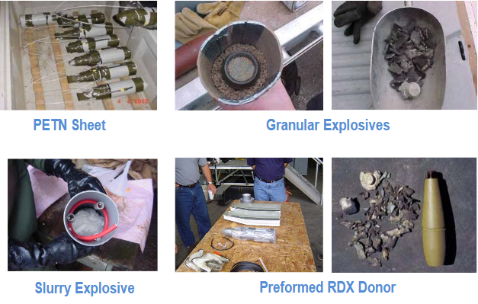
Disposed UXO and Ammunitions

Slide 6
Design Elements
Donovan CDC consists of an elongated double-walled steel structure which is precisely designed to handle sudden impact from shock wave;
Access door is designed for charging batches of explosive and a vent door for discharging after each detonation;
Orificed vent pipes penetrate the chamber walls to controllably release explosion products into exhaust manifolds;
A steel Fragmentation Containment Unit (FCU) is designed to capture shrapnel and debris during the detonation; Chamber interior wall is bolted with armor plates for easy replacement;
The hollows formed between the inner and outer steel wall and inside cavities of access and vent door are filled with a granular shock-damping silica sand which is introduced through filler openings at the top of chamber; Chamber floor is filled with pea gravel;
An expansion tank is attached to CDC to dampen shock wave released from manifolds;
A Donalson Torit dust filtration system is installed to connect expansion tank to collect any emission from the CDC.

Slide 7
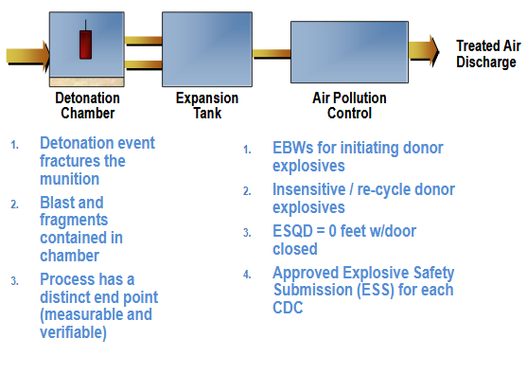
Donovan CDC Diagram

Slide 8
Applications and Design Features
Demilitarization (detonation of old or unserviceable munitions) ;
Destruction of chemical warfare material (CWM);
Render-safe technology for counter terrorism activities;
Emergency Response Technology (UXO) Safe detonation near populated areas;
Destruction of suspected explosive devices and ammunitions;
Forensic analysis and explosives simulation testing and data collection;
Explosive Ordnance Disposal (EOD) operation;
Donovan Controlled Detonation Chamber (CDC) is designed with stationary and transportation version;
Stationary CDC is used for destroying in high capacity (a NEW of minimum 50lb TNT per detonation) with higher productivity;
Transportable CDC is used for accessing to remote sites for explosive disposal operation (a NEW of 25lb TNT per detonation) or delivery of extremely hazard materials.

Slide 9
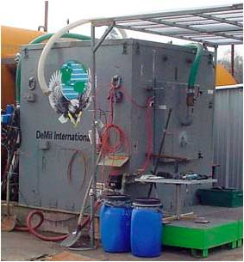
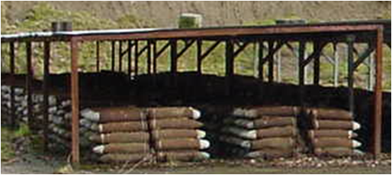
Belgium WWI CWM Destruction
Testing completed by US Army and Belgium MOD on recovered WWI Chemical Warfare Material (CWM) at Poekapelle, Belgium:
  77 mm CLARK (I and II) ,77 mm mustard, 77 mm phosgene, 81 mm smoke and 81 mm white phosphorous;
  Joint US Army and Belgium MOD report concluded CDC capable of destroying CWM shells;
CDC has successfully destroyed above CWM shells.

Slide 10
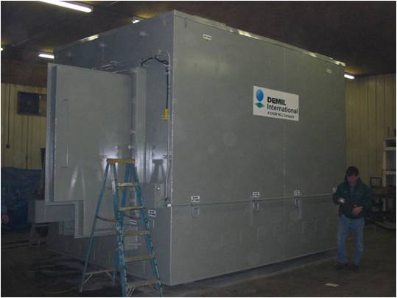
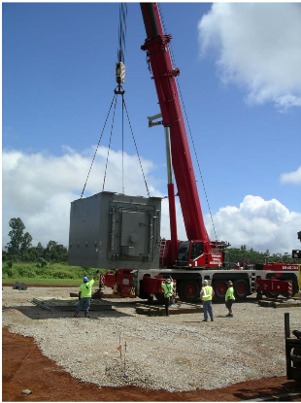
Stationary CDC

Slide 11
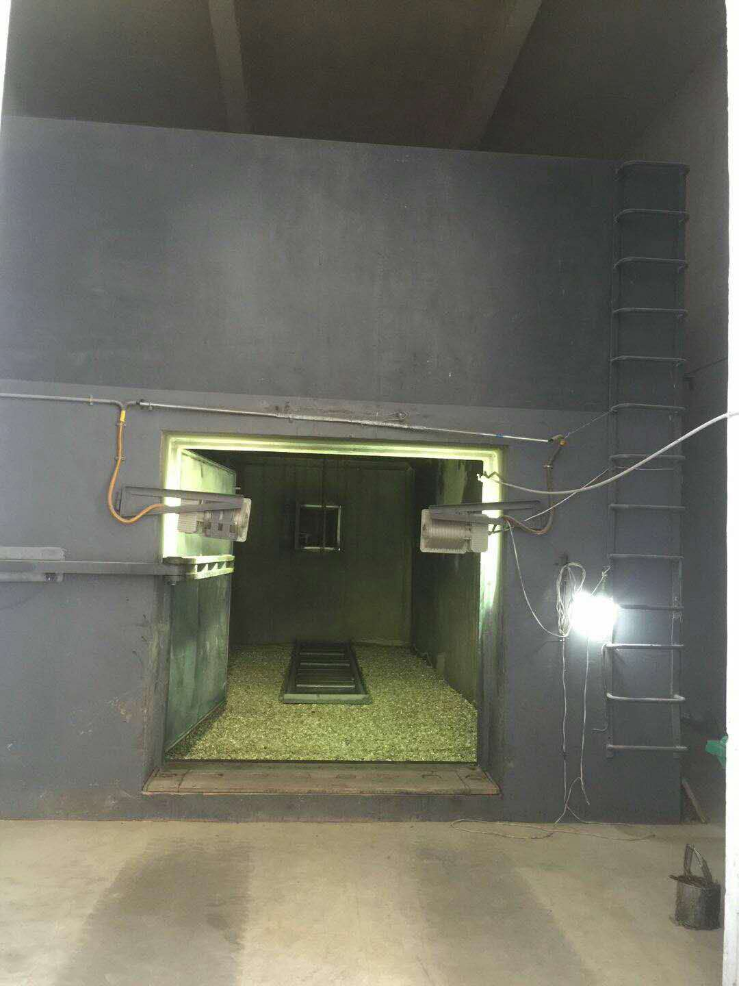
Stationary CDC

Slide 12
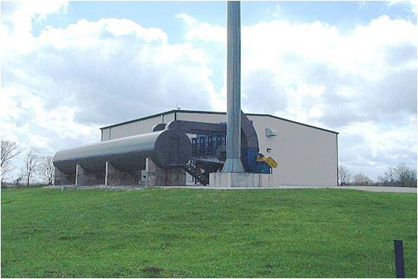
Stationary CDC with Filtration System

Slide 13
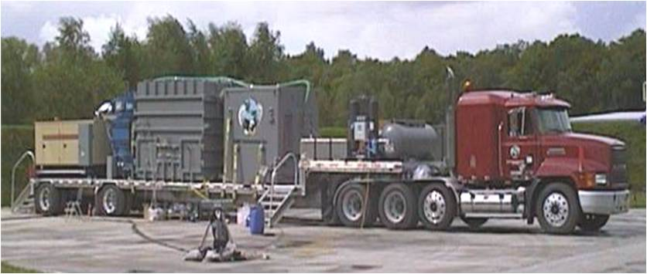
Transportable CDC

Slide 14
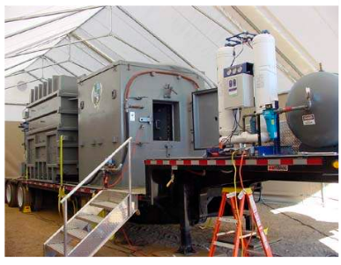
Transportable CDC in Operation

Slide 15
Donovan Portable Chamber
Most of portable explosive receptacles used in large public venues have failed to dispose suspected explosive devices, bombs and other hazardous materials discovered by police or general public during daily security inspection or anti-terrorism missions . Donovan Portable Chamber is designed to provide a most safe tool to provide 360 degree protection during explosive devices disposal;.
The portable chamber is featured with multi-layer steel wall and shock wave passage manifold to allow immediate release of blast pressure and reduction of instant extreme temperature;
An inner fragmentation containment tubular structure prevents shrapnel and debris from flying out of the unit;
A battery-powered chassis allows the chamber to move in and out the buildings and reach to the places freely where suspected explosive devices are spotted;
Each detonation can sustain 2kg of TNT which surpasses all existing products in the market;
The chamber can be used repeatedly if It is properly maintained and operated.
The portable chamber can be deployed in airport, railway station, subway, stadium, shopping mall, convention center, public square where large crows are formed.

Slide 16
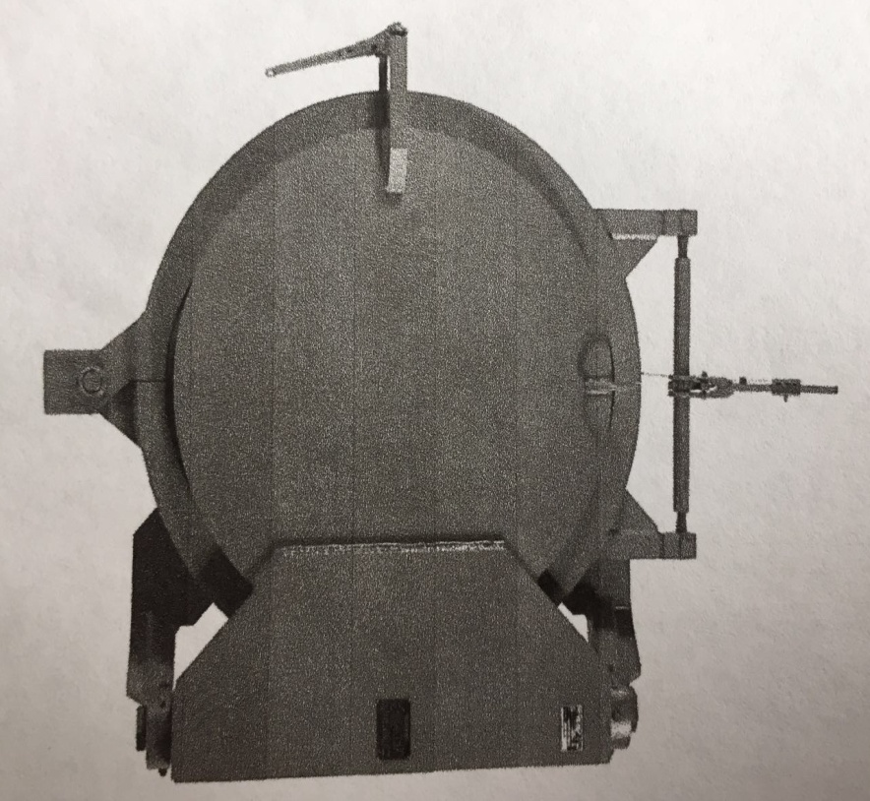
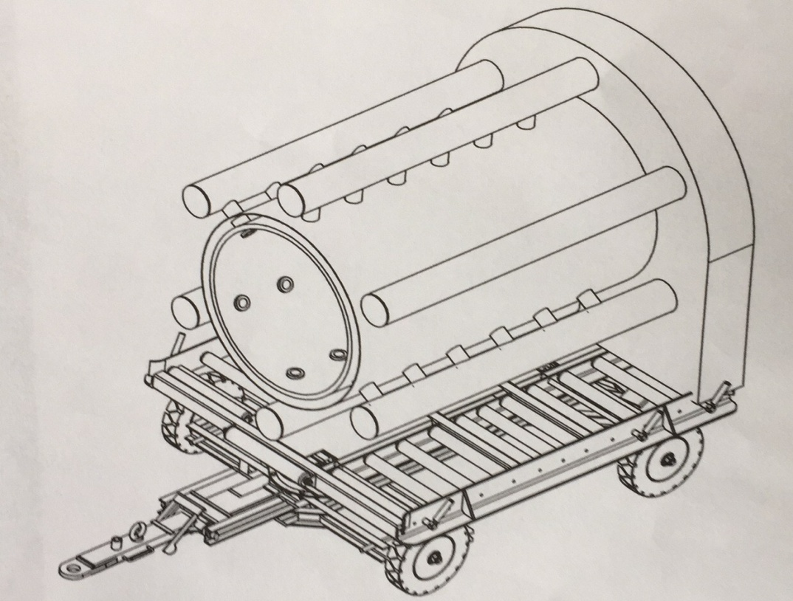
Portable Chamber Side and Inner View

Slide 17
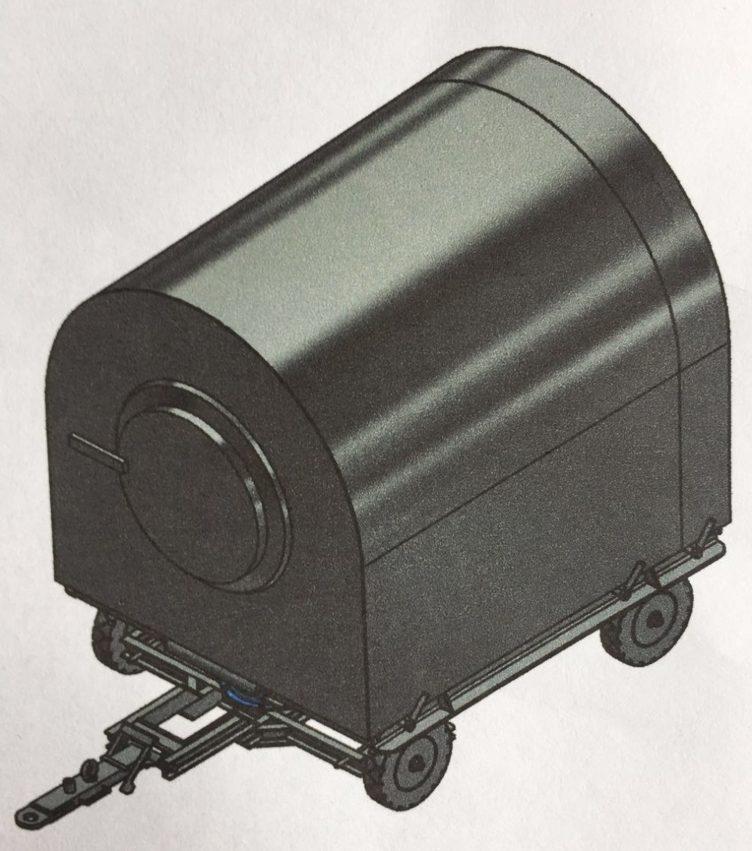
Portable Chamber

Slide 18
Environmental Testing Data
Air Emissions Testing
  Low emission rate for Criteria Pollutants:
    CO (7900 ppmv)
    NOx (NO₂) (9.3 ppmv)
    Particulate Matter = 1.8 mg/dscm
    VOCs (10-20 mg/dscm)
  No SVOCs or energetics detected
  Metals: Mg (2440 ug/dscm), Mn, Fe, Zn, Al and Cu (100-400 ug/dscm) attributable to pea gravel

Slide 19
Environmental Testing Data
Solid Waste Characterization (pea gravel and Torit filter dust samples analyzed for TCLP parameters)
  TCLP Volatiles (MEK at 0.055, limit 200 mg/L)
  No detection of semivolatiles and TCLP metals
  RDX detected in pea gravel (0.74 mg/kg) and dust (0.069 mg/kg)
  Total metals in pea gravel comparable pre and post test except for increases in Cr (1.8 to 6.1 mg/kg) and Cu (3.3 to 161 mg/kg)

Slide 20
Environmental Testing Data
Operator Protection Monitoring
  Particulate Matter (inside the chamber) = 9.3 ±15 mg/m³. OSHA limit of 10 mg/m³ (respiratory protection required)
  VOCs were below OSHA TWA concentrations
  Magnesium, iron, and aluminum averaged 0.32, 0.083, and 0.033 mg/m³, respectively (OSHA limits at or above 5 mg/m³)
  Noise monitoring results (OSHA Limit 85 dBA 8-hr and 140 dBC instantaneous):
    Det Chamber baseline = 55 dBA at chamber door, instantaneous peak at detonation = 145 dbA
    Near generator = 80-95 dBA

Slide 21
Contact Us
Donovan Technology, Inc.
Haideng Technical Service (Dalian) Co., Ltd.
400 Williams Mine Road, Nortonville, KY 42442
Contact: Sam Donovan
Phone: (270) 676-3192
Email: sdonovan@dciedh.com

